Slide 1

Accelerating the digital future

Slide 2
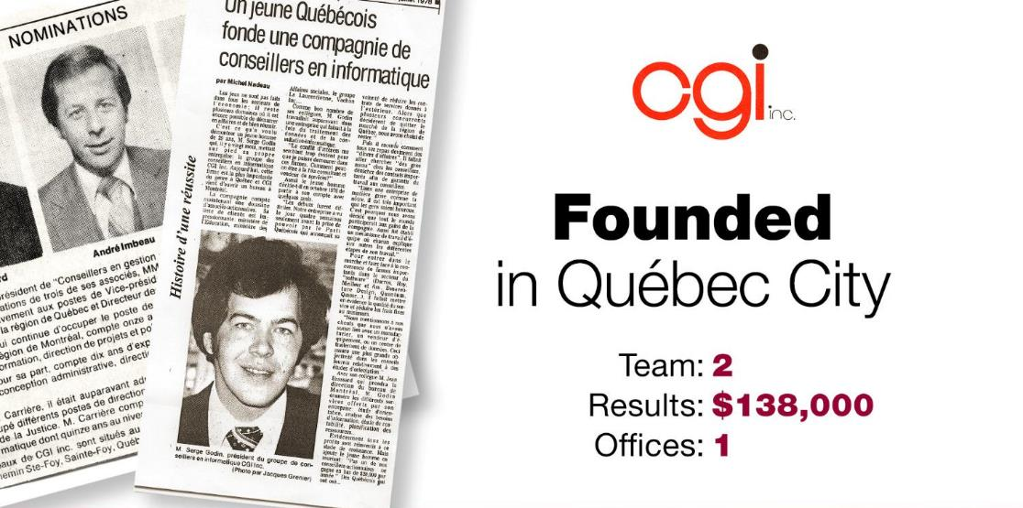
1976 | 1986 | 1990 | 1998 | 2001 | 2004 | 2012 | Today

Slide 3
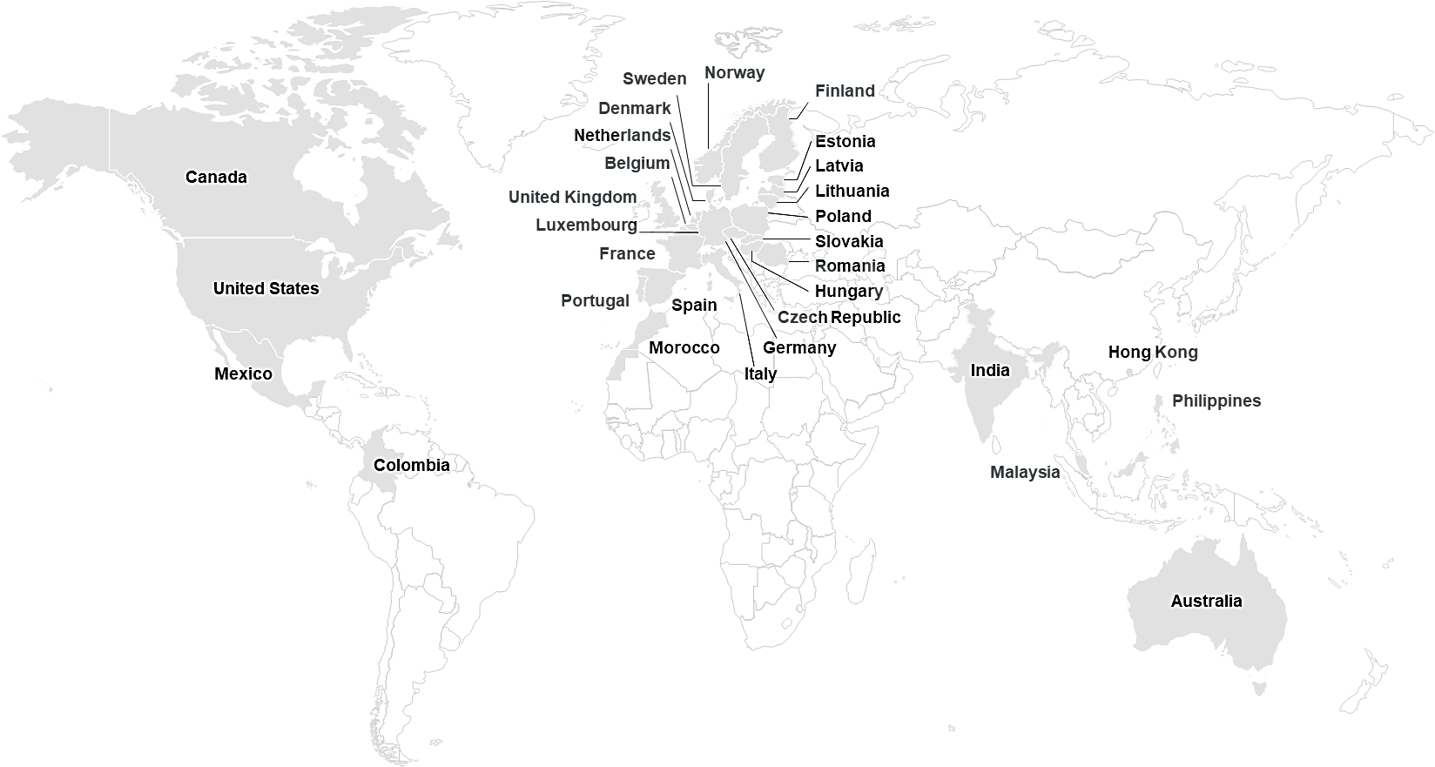
CGI at a glance
Founded in 1976 45+ years of excellence
CA$12.1 billion revenue
93,000 consultants
400 locations in 40 countries
5,500 clients benefiting from end-to-end services
Notes:
CGI is one of the few firms with the scale, reach and capabilities to meet clients’ digital transformation needs. We provide innovative, end‑to‑end IT and business consulting services through our client-proximity business model, working side-by-side with clients and drawing upon our global capabilities to help identify, develop, implement and operate the strategies and solutions needed to meet their customer and citizen expectations.
Our global footprint of 400 offices located across 40 countries includes 84,000 members, a majority of whom are shareholders, who serve as trusted partners to over 5,500 clients globally. With more than four decades of sustained growth, we provide focused expertise in 10 industries, and augment our services with a portfolio of IP-based solutions.

Slide 4
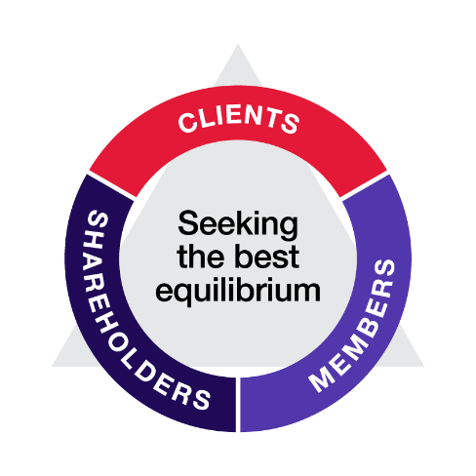

Our members
Our DNA
Diversity at CGI
Ownership
Career development
The CGI Constitution is in the DNA of our company; it defines our aspirations and values. By understanding and embracing our Constitution, we work towards the same goals and sustain the same level of achievement that’s brought us to where we are today. | We actively encourage diversity in our workplace. We believe that diversity creates a cohesive and positive environment where all members have the opportunity to thrive and deliver for our clients. | We view our professionals as company owners; our aim is for every member to reap the benefits of ownership. As a company owner, our members’ success mirrors ours. | We support our members’ career growth every step of the way, facilitating the opportunities for them to hone their skills, supporting them to do what they do best, better.

Slide 5

Culture of ownership and accountability
We offer and deliver high quality in our work and your results
85%
Member Shareholders
95%
Projects delivered on-time and within budget
9.3/10
Client Satisfaction score, signed by clients
9.0/10
Client Innovation score
Notes:
Our commitment to exceed the expectations of our clients is demonstrated by an overall 9 out of 10 client satisfaction score, reported directly by our clients through in-person satisfaction assessment sessions; and, our industry-leading 95% on-time, within budget project delivery track record, is a testament to our commitment to operational excellence.
Going above and beyond to deliver value for our clients Our clients are satisfied when we bring practical innovation that helps them create new business value. Proactive listening serves as a key step in delivering this value through innovative services and solutions.
Through our Client Satisfaction Assessment Program (CSAP), we meet in-person with clients to evaluate our performance and discuss further ways we can help. The CSAP assessments, which clients sign, represent a “report card” on CGI’s performance — one that demonstrates a commitment to continuous improvement.
Client satisfaction scores, signed by clients 2021 vs 2020 scores:
Overall satisfaction 9.3/10 vs 9.2/10
Client loyalty 9.43/10 vs 9.37/10
Industry knowledge 9.24/10 vs 9.16/10
Technology expertise 9.19/10 vs 9.10/10
Innovation 8.96/10 vs 8.85/10

Slide 6
Range of services and differentiators
End-to-end services | Strategic IT and business consulting |  | Systems integration | Managed IT and business process services
 | Intellectual property solutions and services as value creation accelerators for clients
Differentiators |  | Client-proximity model
 |  | Global antenna for the benefit of our clients
 |  | Local and global expertise by industry
 |  | Global delivery network
Notes:
Customer and citizen demand for new digital services continues to shape our clients’ priorities and key initiatives for becoming digital. At the same time, technology no longer just enables change; it drives it. Given this, technology is moving from being a support function to being core to clients’ business and operations. Yet, as technology becomes more important, humans continue to be the key asset.
In the midst of these profound changes across industries, clients increasingly favor global, end-to-end services firms. They require trusted partners with deep industry and technology knowledge, and a proven ability to provide relevant advice while delivering quality and innovation anywhere in the world.
CGI delivers an end-to-end portfolio of capabilities, from high-end IT and business consulting to systems integration to IT and business process outsourcing services. Our services are supported by our unique differentiators:
Client-proximity operating model: CGI organizes operations within metro markets where clients have concentrated footprints. Our client-proximity model empowers local teams to build strong, trusted, in-person relationships and ensure accountability for delivering client success. Through this proximity, CGI gains deep knowledge of our clients’ businesses and industries and stays attuned to market and cultural needs. It also enables us to deliver innovative solutions proactively, and to grow alongside our clients.
Global antenna for our clients: Through the CGI Client Global Insights, we provide a valuable global antenna by industry—based on facts, not hype—to benchmark best practices that lead to continuous improvement. Our benchmarking data comes from a knowledge-base that reflects insights from 5,500 client organizations located in countries representing 82% of the world’s IT spend.
Industry expertise at the local level: Through our focus on 10 industries and dozens of sub-industries, we provide local experts who understand clients’ industries and local business environment. These experts are supported by global insights coming from our network of industry-focused centers of excellence, emerging technology practices and global delivery centers, providing clients with applied innovation, clarity of accountability, and measurable results.
Intellectual Property built in collaboration with clients : CGI’s 170+ digital business solutions support our clients’ mission-critical business functions and accelerate their digital transformation. These industry and cross-industry solutions include digital-enabling software applications, reusable frameworks and innovative delivery methodologies such as Software as a Service.
Global delivery network focused on outcomes: At CGI, our best-fit global delivery model includes onshore, nearshore and offshore delivery centers that support client-proximity teams in accelerating clients’ transformation. With skilled resources operating under a common governance model, centers are strategically located throughout North America, Europe and Asia Pacific to provide the best mix of services configured to clients’ needs and preferences.

Slide 7

CGI and Google Cloud launch the United Nations Industrial Development Organization Sustainability Planet Platform
The declaration, which was signed by Gerd Muller, Director General of UNIDO and Mattie Yeta PhD, Chief Sustainability Officer for CGI in the UK, considers the importance of technology, innovation, and collaboration in addressing major challenges like climate change, reducing hunger and enhancing sustainable supply, and looks to work with partners such as Google Cloud to achieve global sustainability.

Slide 8
AI and VantagePOB and The Challenge…

Slide 9
AI is not new and the time to act is now
Sample CGI AI Use Cases
⬇ 2020s Predict adverse drug events On- and off-board autonomy and AI systems for Europe's first Mars rover PoC: Using OpenAI GPT3.5/4 for code modernization (productivity increase in code generation 300+%)
⬇ 2010s Predict oil-field production, impact on 300+ oil wells when increasing individual well production Optimize container ship freight loading process Analyze collective human emotions at event Detect cracks in steel manufacturing
⬇ 2000s Discover bank fraud, money laundering Discover errors in healthcare billing
⬇ 1990s Predict customer behavior and preferences (e.g., churn, credit risk, recommendations)
Frontier AI rapidly evolving
The new upsurge
AI everywhere
AI’s iPhone Moment with
ChatGPT
The second surge
The second significant decline
The first
golden age
AI
winter
Generative AI
(from automation to creation)
Bottlenecks of expert systems
AI (deep learning) takes off with cloud computing, and big data
New ITs drove AI to be innovative and practical
The research objective was lost
The success of expert systems leads from theory to application
AI was born
1956
1960
1970
1980
1990
2000
2010
2020
2030
Figure adapted from the “Reflection of the development history of AI,” published in the article “Artificial Intelligence in Product Lifecycle Management” by Wang et al. in 2021

Slide 10
2024 is our 20 Year Anniversary for VantagePOB
Over 43,000 flights and 830,000 personnel movements in 2023
UK
Tracks personnel at 186 locations
Supports 42 operators
Globally
Australia
Nigeria
Iraq
Trinidad and Tobago, Oman, Caspian Sea & Indonesia
Senegal
Offshore Wind
Israel
Qatar
Equitorial Guinea
Tunisia
Angola

Slide 11

Use AI to build an innovative solution for offshore travel management!
The Challenge…
Your task is use AI to develop an innovative solution that adds-value to offshore travel management. Your solution should leverage AI technologies, potentially including data analysis, machine learning, predictive modelling, and natural language processing

Slide 12
What we’d like to you to do:
Use AI to develop a solution that adds-value to offshore travel
For example…
A CV builder for an offshore worker
A predictive scheduling system
An interactive briefings dashboard
A communication assistant
Create a comprehensive dataset using AI
You have access to an anonymized dataset derived from VantagePOB (the logistics system for all offshore oil and gas travel). This dataset provides you detailed information for all helicopter travel in a month to one offshore platform.
Use our “compact dataset” to generate a more representative dataset, with more depth and richness e.g. for the entire North Sea or the world. Consider augmenting with other data e.g. weather, helicopter fuel consumption, reliability, safety etc.
Presentation and use AI to help you
The AI technologies you used and how well they worked
The dataset you created
A working MVP – we’d like to see something working
The value your tool will bring to the industry
What you learned from the exercise

Slide 13
Insights you can act on
Founded in 1976, CGI is among the largest IT and business consulting services firms in the world.
We are insights-driven and outcomes-based to help accelerate returns on your investments. Across hundreds of locations worldwide, we provide comprehensive, scalable and sustainable IT and business consulting services that are informed globally and delivered locally.

